Slide 1

CO2015 Exercise – BJT

Slide 2
When a transistor is used as a switch, it is stable in which two distinct regions?
saturation and active
active and cutoff
saturation and cutoff
none of the above
Notes:
C

Slide 3
For a silicon transistor, when a base-emitter junction is forward-biased, it has a nominal voltage drop of
0.7
0.3
0.2
V_{CC}
Notes:
A

Slide 4
A certain BJT has I_{B} = 167uA, I_{C} = 15mA, the amplifier DC factor is:
15
167
90
All are not correct

Slide 5
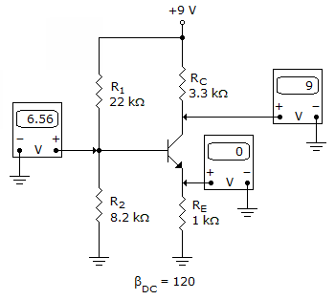
Refer to the given figure. The most probable cause of trouble, if any, from these voltage measurements is
Notes:
Base and Emitter is opened

Slide 6
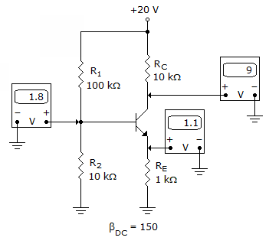
Refer to the given figure. The most probable cause of trouble, if any, from these voltage measurements is
Notes:
No problem

Slide 7
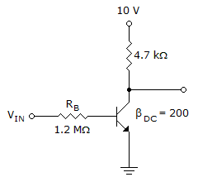
Refer to this figure. If V_{CE} = 0.2 V, I_{C(sat)} is

Slide 8
Refer to this figure. Determine the minimum value of I_{B} that will produce saturation (V_{CE}(sat) = 0.2V).
Notes:
10=4.7*10^3*Ic+0.2
Ic = 2.085 ma.
Ib = 2.085/200 = 10.425 uA .

Slide 9
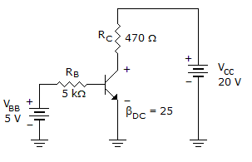
Refer to this figure. The value of V_{BC} is
Notes:
-9.2

Slide 10
CO2015 Exercise – FET

Slide 11
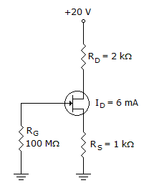
Refer to the given figure. Calculate the value of V_{DS}

Slide 12
Answer
2V
Notes:
20V = 2k * ID + VDS + 1K*ID
VDS = 20 – (2 + 1)*6 = 2V

Slide 13
Refer to figure shown below. Determine the value of V_{S}.
Notes:
VS = RS * ID = 6V

Slide 14
Answer
6V

Slide 15
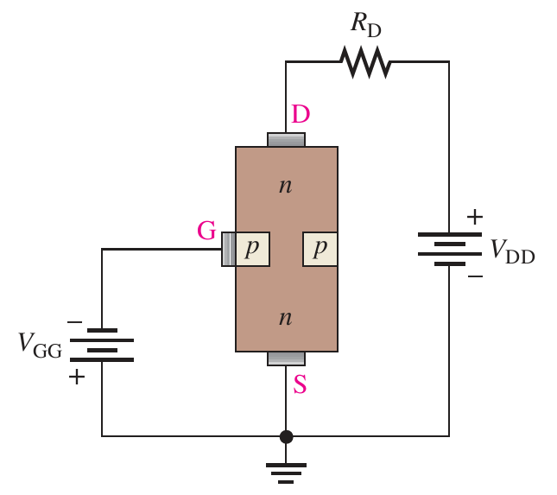
A self-biased n-channel JFET has a V_{D} = 6 V. V_{GS} = –3 V. Find the value of V_{DS}.
-3V
-6V
3V
6V

Slide 16
Answer
3V

Slide 17
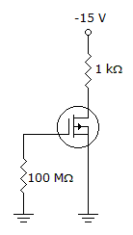
Refer to the given figure. I_{D} = 6 mA. Calculate the value of V_{DS}

Slide 18
-9V
In general V_{DS}= V_{DD}-(I_{D}*R_{D}) But in figure direction of FET transistor is out of drain so, Id becomes negative .

Slide 19
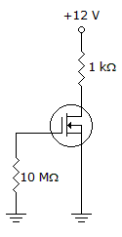
Refer to the given figure. I_{D} = 6 mA. Calculate the value of V_{DS}

Slide 20
Answer
6V

Slide 21
Refer to figure given below. Determine the value of V_{GS}

Slide 22
Answer
-6V

Slide 23
Refer to figure show below. Calculate the value of V_{D}

Slide 24
Answer
8V

Slide 25
For a JFET, the value of V_{DS} at which I_{D} becomes essentially constant is the
pinch-off voltage.
cutoff voltage.
breakdown voltage.
ohmic voltage.

Slide 26
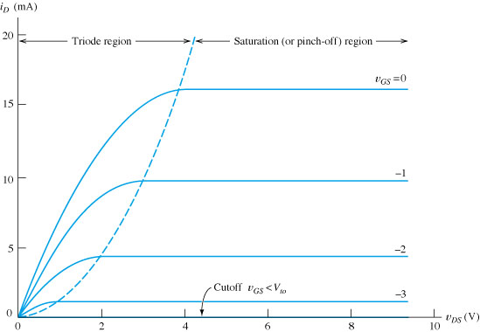
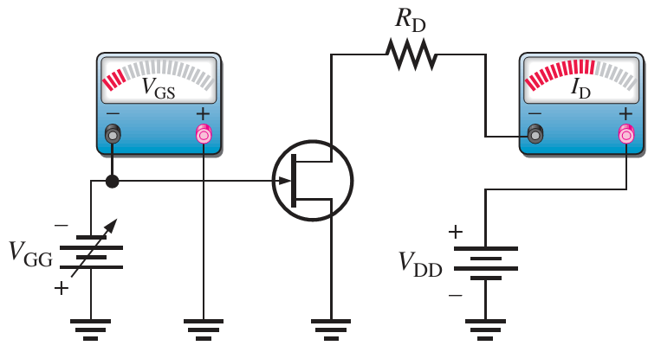
Answer: A

Slide 27
The value of V_{GS} that makes I_{D} approximately zero is the
Pinch-off voltage
Cut-off voltage
Breakdown voltage

Slide 28
Answer
B

Slide 29
The ________ has a physical channel between the drain and source.
DFET
EFET
VFET

Slide 30
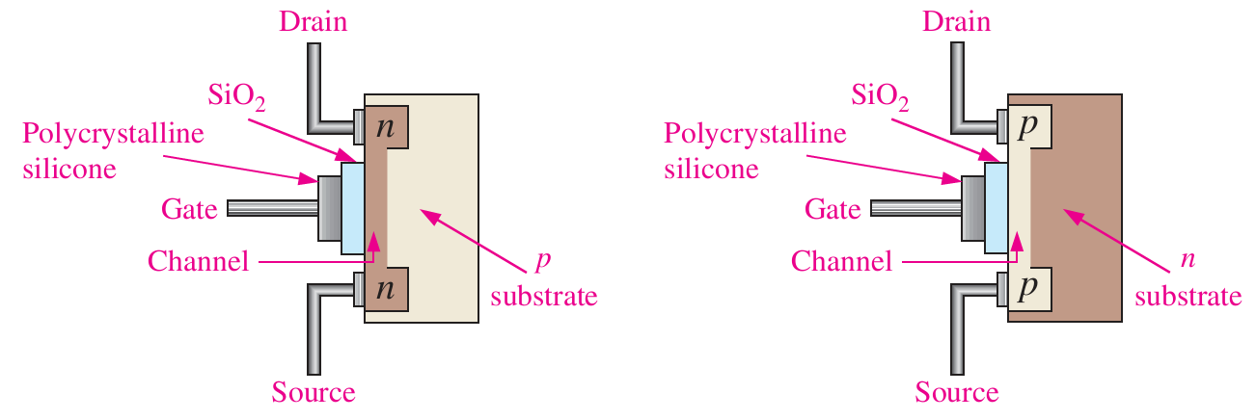
Answer: A

Slide 31
What type(s) of gate-to-source voltage(s) can a depletion MOSFET (D-MOSFET) operate with?
Zero
Positive
Negative
All of them

Slide 32
Midpoint bias for a D-MOSFET is I_{D} = ________, obtained by setting V_{GS} = 0
I_{DSS} / 2
I_{DSS} / 3.4
I_{DSS}
Notes:
C

Slide 33
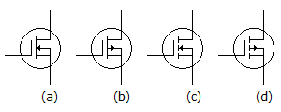
Identify D-FET p channel

Slide 34
Answer
B

Slide 35
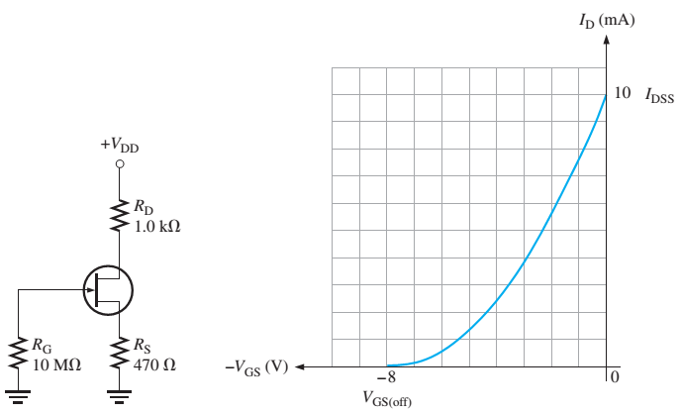
Determine V_{GS} and I_{D}

Slide 36

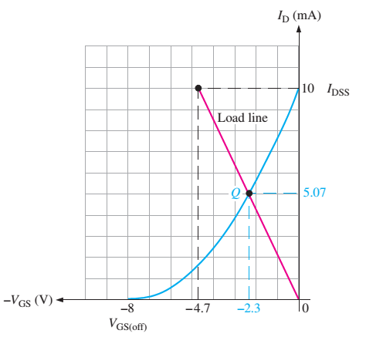
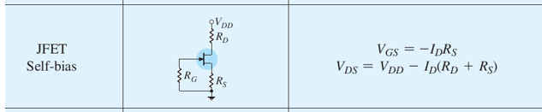
Answer
Determine the Load line
I_{D} = 0
I_{D} = I_{DSS}
Q is the intersection point of the load line & transfer curve.
I_{D} = 5.07 mA
V_{GS} = -2.3V

Slide 37
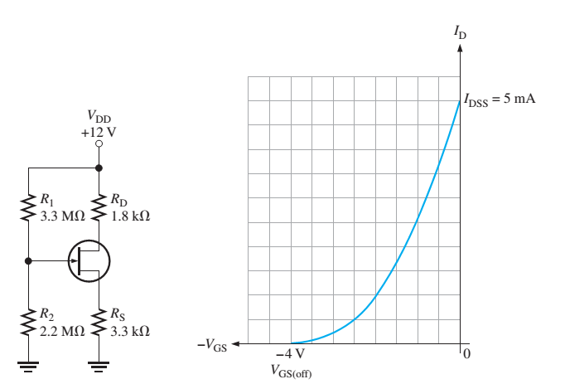
Determine V_{GS} and I_{D} for the given JFET, where
I_{DSS} = 5mA and V_{GS(off)} = -4V

Slide 38
CO2015 Exercise – Op Amp

Slide 39
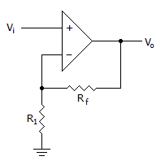
Calculate the output gain of the circuit if R1 = 100(Ohm) and Rf = 1(KOhm)

Slide 40
Answer
11

Slide 41
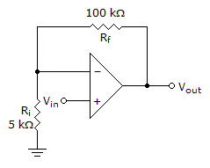
Refer to the given figure. A dc input signal of –50 mV is applied. You would measure ________ from the inverting input to ground.
50mV
1.05V
-1.05V
-50mV

Slide 42
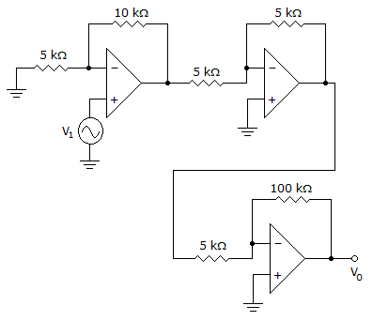
Calculate the input voltage if the final output is 10.08 V
0.168V

